Slide 1
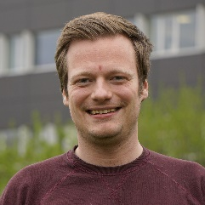

Week | Weekdag | Start datum | Starttijd | Aard | Lokaal, Gebouw, Campus | Lesgever | Practicumhelper | Commentaar
W 10 | Maandag | 02-03-2026 | 08:30 | hoorcollege | Leslokaal 3.1. K3. Campus UZ Gent | Robbin Bouwmeester |  | Introduction + regression
W 10 | Maandag | 02-03-2026 | 13:00 | werkcollege | Leslokaal 3.2. K3. Campus UZ Gent |  | Alireza | SimpleLR
W 10 | Dinsdag | 03-03-2026 | 08:30 | hoorcollege | Leslokaal 3.1. K3. Campus UZ Gent | Robbin Bouwmeester |  | logistic regression + regularization
W 10 | Dinsdag | 03-03-2026 | 13:00 | werkcollege | Leslokaal -1.2. B3. Campus UZ Gent |  | Alireza | Model_selection
W 10 | Woensdag | 04-03-2026 | 08:30 | hoorcollege | Auditorium C. Dwarsgebouw Links. Campus UZ Gent | Robbin Bouwmeester |  | Model complexity + bias and variance
W 10 | Woensdag | 04-03-2026 | 13:00 | werkcollege | Leslokaal 3.2. K3. Campus UZ Gent |  | Caroe | Regularization
W 10 | Donderdag | 05-03-2026 | 08:30 | hoorcollege | Leslokaal 3.1. B3. Campus UZ Gent | Jasper Zuallaert
W 10 | Donderdag | 05-03-2026 | 13:00 | werkcollege | Lokaal 0.2 - Gertrude Elion. Blok A. Campus Heymans |  | Enrico | Kaggle competition
W 10 | Vrijdag | 06-03-2026 | 08:30 | hoorcollege | Lokaal 0.2 - Gertrude Elion. Blok A. Campus Heymans | Robbin Bouwmeester |  | Ensemble + autoML + other modern classical ML
W 10 | Vrijdag | 06-03-2026 | 13:00 | werkcollege | Leslokaal 3.2. K3. Campus UZ Gent |  | Enrico | DT
W 11 | Maandag | 09-03-2026 | 08:30 | hoorcollege | Leslokaal 3.2. K3. Campus UZ Gent | Ralf Gabriels |  | Deep Neural Networks
W 11 | Maandag | 09-03-2026 | 13:00 | werkcollege | Leslokaal 3.2. K3. Campus UZ Gent |  | Robbe
W 11 | Dinsdag | 10-03-2026 | 08:30 | hoorcollege | Leslokaal 3.1. K3. Campus UZ Gent | Ralf Gabriels |  | CNNs
W 11 | Dinsdag | 10-03-2026 | 13:00 | werkcollege | Leslokaal -1.2. B3. Campus UZ Gent |  | Sander
W 11 | Woensdag | 11-03-2026 | 08:30 | hoorcollege | Lokaal 0.1 - Rosalyn Yalow. Blok A. Campus Heymans | Ralf Gabriels |  | RNNs
W 11 | Woensdag | 11-03-2026 | 13:00 | werkcollege | Leslokaal 3.1. K3. Campus UZ Gent |  | Robbe
W 11 | Donderdag | 12-03-2026 | 08:30 | hoorcollege | Leslokaal 3.2. K3. Campus UZ Gent | Ralf Gabriels |  | Transformers and co
W 11 | Donderdag | 12-03-2026 | 13:00 | werkcollege | Leslokaal 5.2. B3. Campus UZ Gent |  | Sander
W 11 | Vrijdag | 13-03-2026 | 08:30 | hoorcollege | Auditorium C. Dwarsgebouw Links. Campus UZ Gent | Ralf Gabriels |  | Generative models
W 11 | Vrijdag | 13-03-2026 | 13:00 | werkcollege | Leslokaal 3.1. K3. Campus UZ Gent |  | Alireza
W 12 | Maandag | 16-03-2026 | 08:30 | hoorcollege | Leslokaal 5.1. B3. Campus UZ Gent | Ralf Gabriels, Robbin Bouwmeester |  | Microteaching
W 12 | Maandag | 16-03-2026 | 13:00 | werkcollege | Leslokaal 5.1. B3. Campus UZ Gent
W 25 | Donderdag | 18-06-2026 | 13:00 | schriftelijke evaluatie met meerkeuzevragen, schriftelijke evaluatie met open vragen | Leslokaal 3.2. K3. Campus UZ Gent
Robbin Bouwmeester
Ralf Gabriels

Slide 2

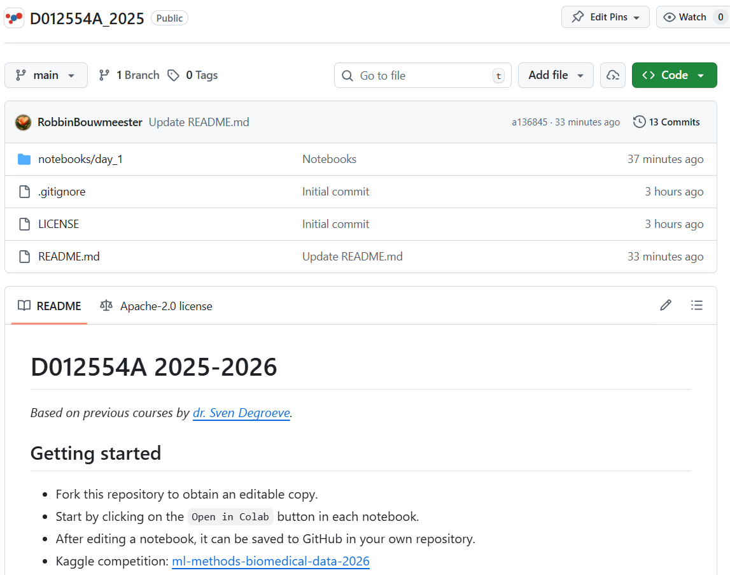

github.com/CompOmics/D012554A_2025/
kaggle.com/competitions/
ml-methods-biomedical-data-2026/

Slide 3
Robbin Bouwmeester
Ralf Gabriels

Slide 4
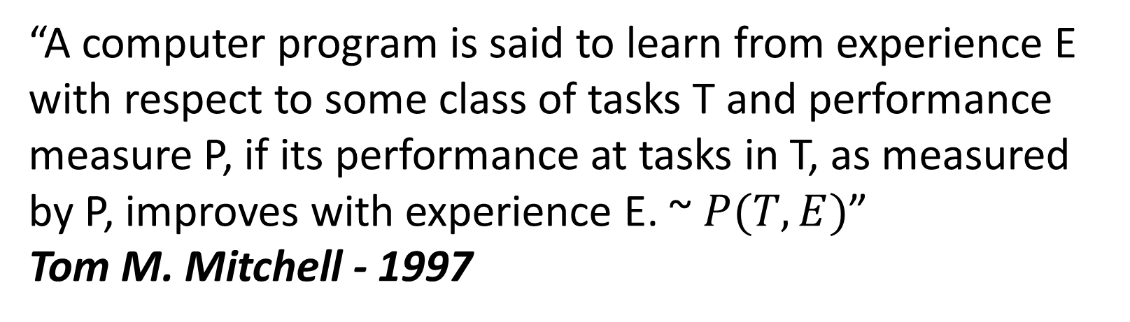
Machine learning was coined in 1958 by Arthur Samuel
“field of study that gives computers the ability to learn without being explicitly programmed.”
Arthur Samuel - 1958
“A computer program is said to learn from experience E with respect to some class of tasks T and performance measure P, if its performance at tasks in T, as measured by P, improves with experience E. ~ $P(T,E)$”
Tom M. Mitchell - 1997

Slide 5
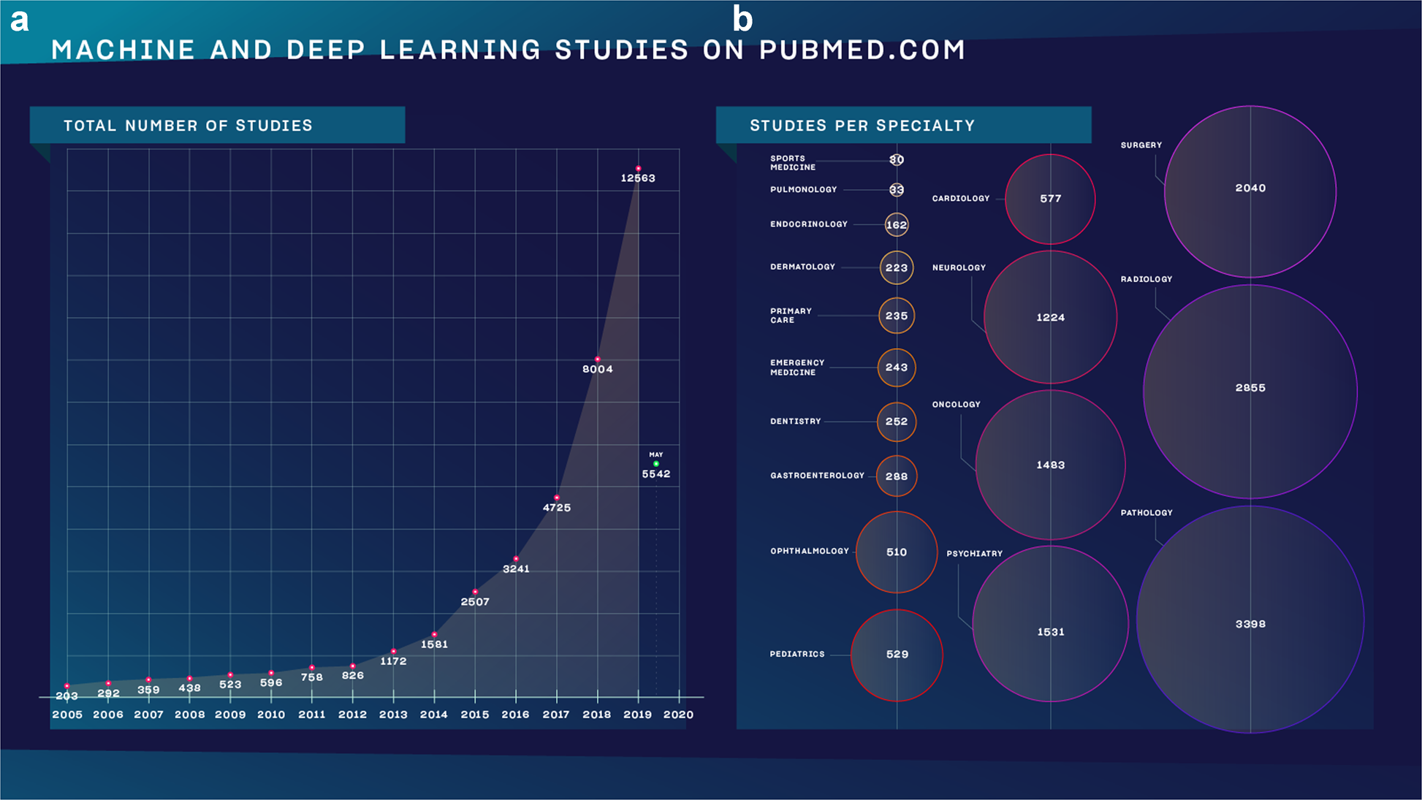
Why follow this course?
Meskó, B., Görög, M. A short guide for medical professionals in the era of artificial intelligence. npj Digit. Med. 3, 126 (2020)

Slide 6

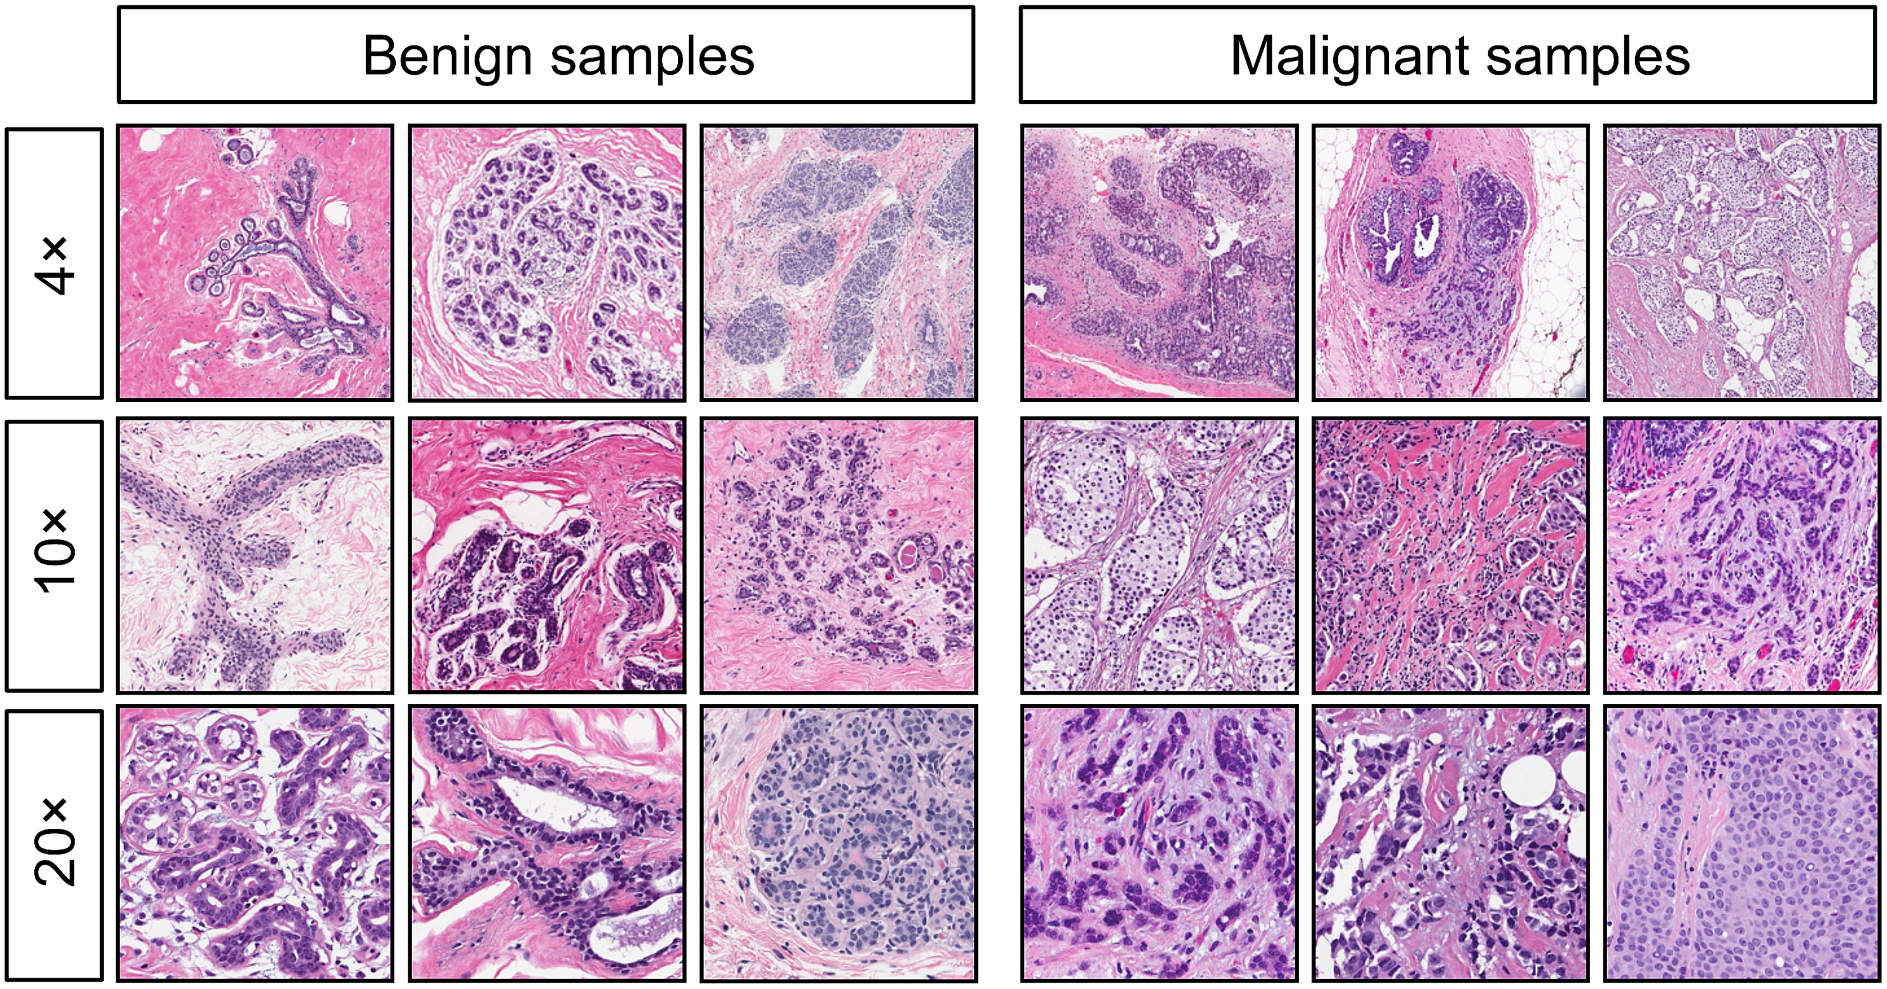
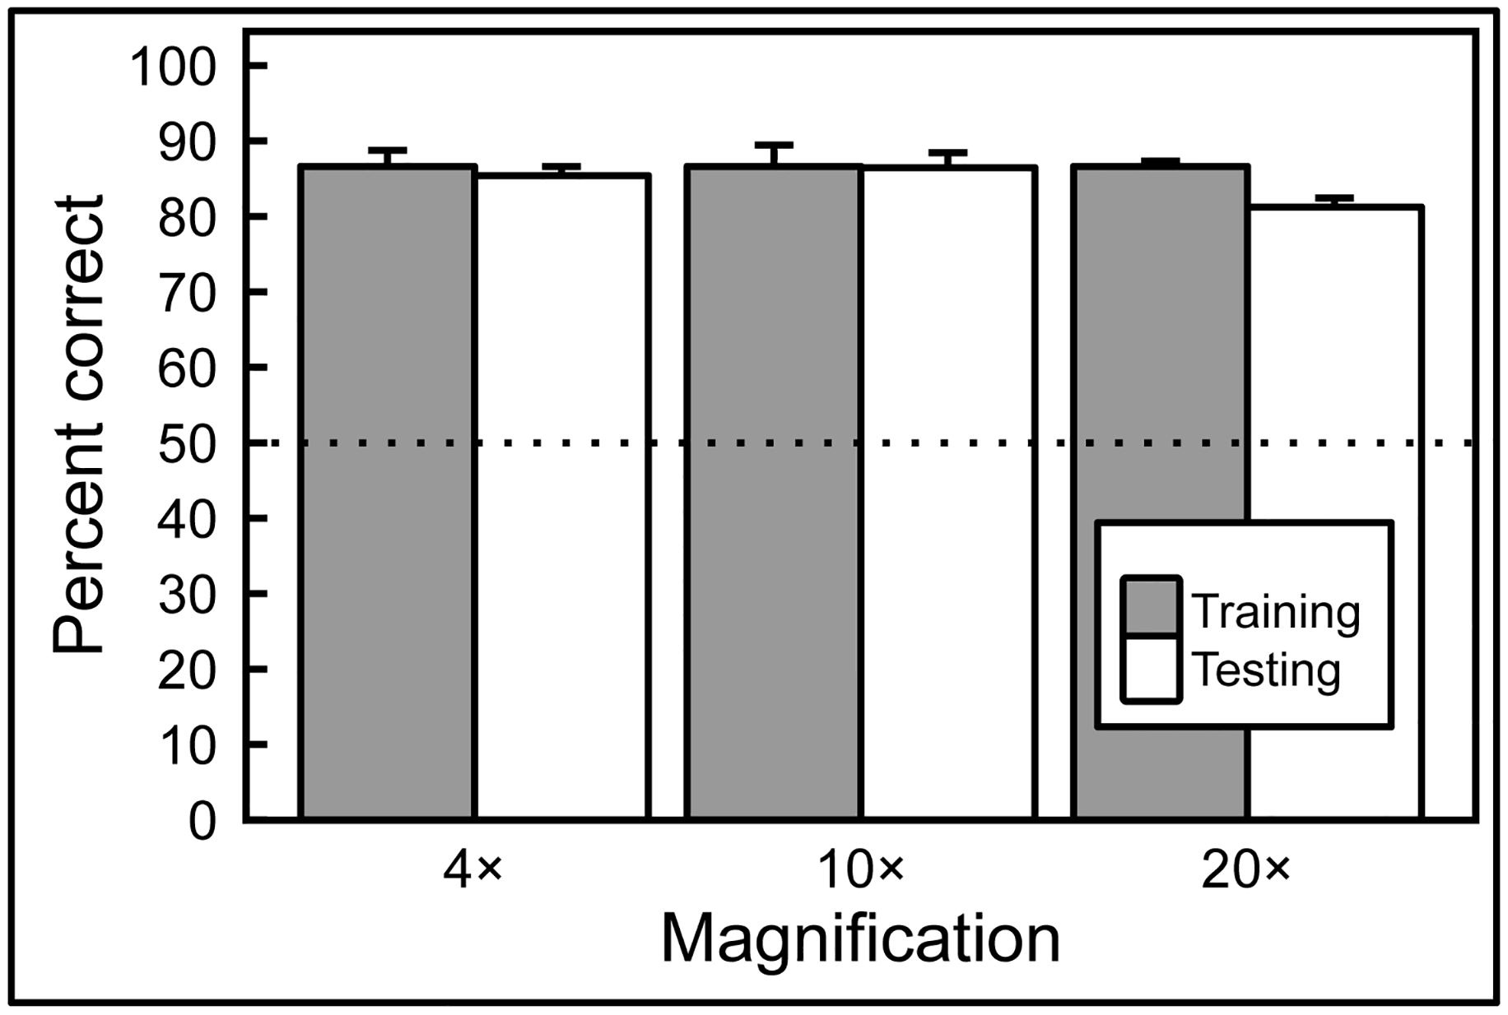
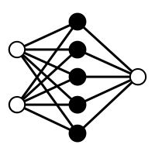
Human expert competing with Artificial Intelligence (Machine Learning model) to classify benign or malignant breast cancer slides
Human Expert
Machine Learning

Slide 7
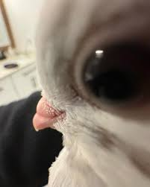
I lied; multiple pigeons learned to do this in just 14 days. However, there are similarities with Machine Learning
Human Expert

Slide 8
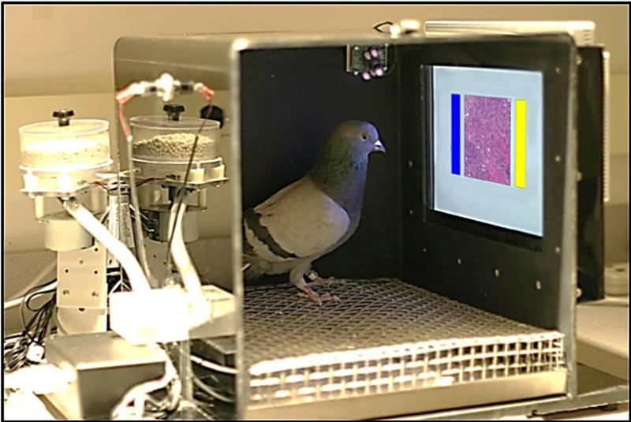
ML trains a model from experience (data) with respect to a task and performance measure that should be able to generalize
Using Pigeons to Diagnose Cancer | Scientific American

Slide 9

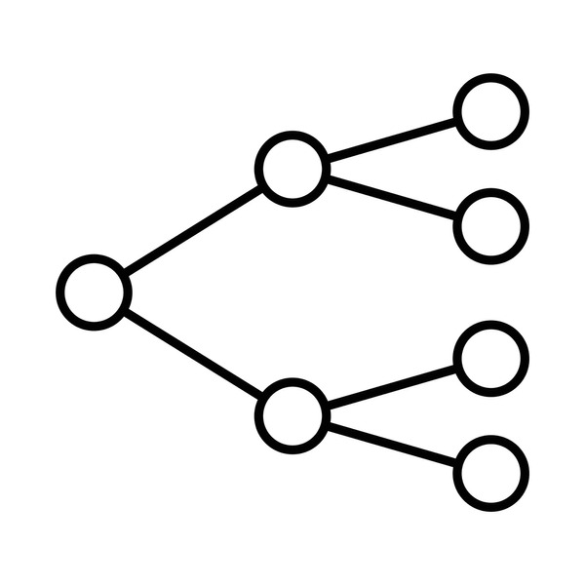
Machine learning maps between data (features) and a target value, from a trained model you can obtain predictions when providing the model with only data and an unknown target
Data (features)
Model
Target

Slide 10
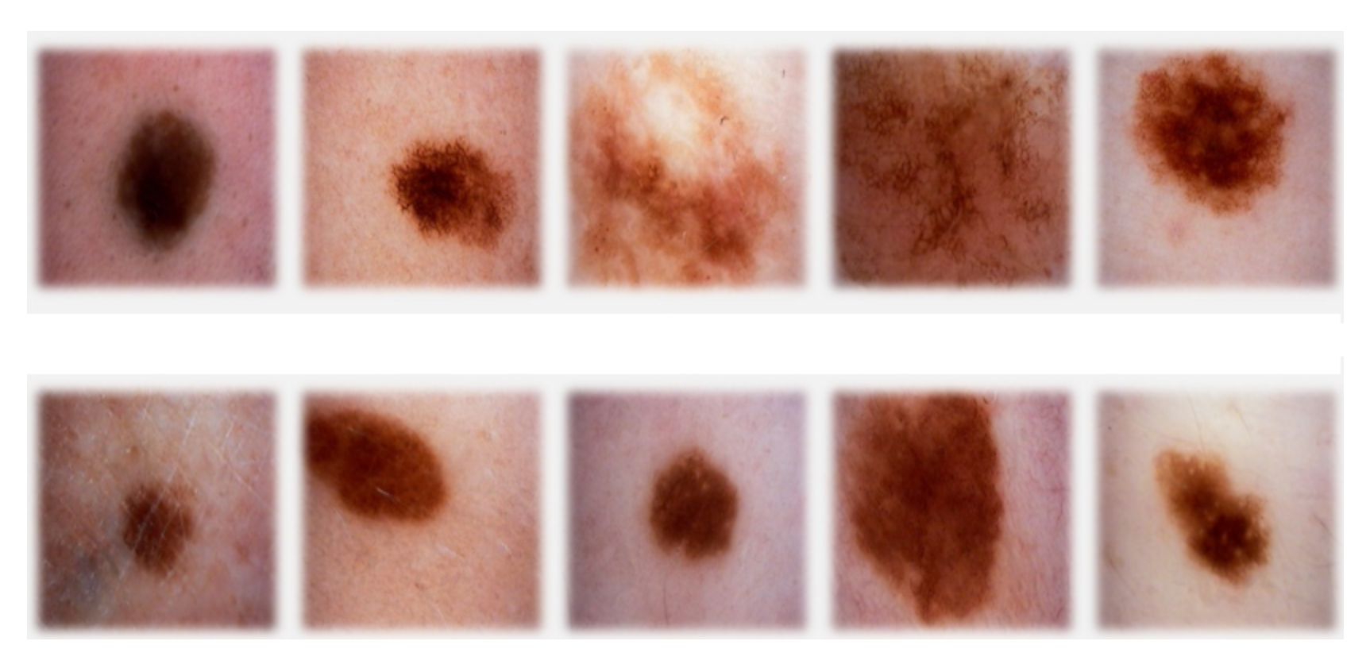
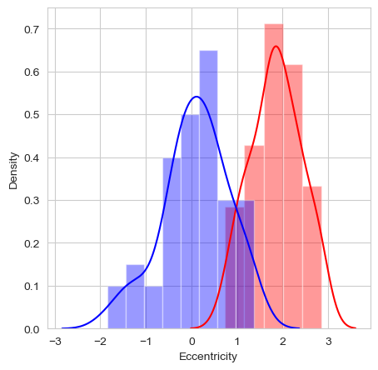
Skin melanoma as a simplified example of how a model learns;
note that a computer only works with numbers!
Data (features)
Model
Target
Eccentricity
1
<= -2.0
> -2.0
0
2
0
1
1
-0.5
1.8

Slide 11
A random decision boundary to start, the difference between predictions and target are used to move the boundary
Data (features)
Model
Predictions
Target
Eccentricity
1
1
<= -2.0
> -2.0
1
0
2
0
1
1
1
-0.5
1.8

Slide 12
A decision boundary is optimized; based on presented data for a task and performance measure that should be able to generalize
Data (features)
Model
Predictions
Target
Eccentricity
1
1
<= 1.0
> 1.0
0
0
2
0
1
1
1
-0.5
1.8

Slide 13







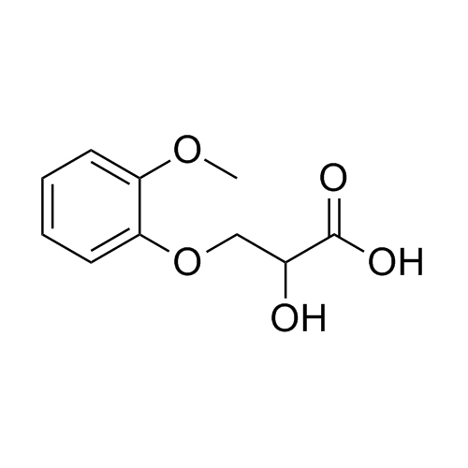
AI has an impact on many different healthcare topics; from small molecules to medical records
Biomedical analytics
Medical imaging
ECG
Drug design
Omics
Medical records

Slide 14
AI has an impact on many different healthcare topics; from small molecules to medical records
Biomedical analytics
Medical imaging
ECG
Type of data
Tabular
Type of models
Tree-based
Continuous
Neural-network
(deep learning)
Target
Disease state
Anomaly detection
Drug design
Omics
Medical records
Ning et al. Scientific Reports (2025); Lauritsen et al. Artificial Intelligence in Medicine (2020)
Notes:
https://www.nature.com/articles/s41598-025-09439-4
https://www.sciencedirect.com/science/article/pii/S0933365719303173

Slide 15
AI has an impact on many different healthcare topics; from small molecules to medical records
Biomedical analytics
Medical imaging
ECG
Type of data
Images/videos
Type of models
Tree-based
Continuous
Convolutional
Neural-network
(deep learning)
Target
Disease state
Segmentation
Anomaly detection
Drug design
Omics
Medical records
Le Dinh et al. Applied Sciences (2022)
Notes:
https://www.mdpi.com/2076-3417/12/10/4861

Slide 16
AI has an impact on many different healthcare topics; from small molecules to medical records
Biomedical analytics
Medical imaging
ECG
Type of data
Temporal ordered (sequential)
Type of models
Tree-based
Continuous
Recurrent
Neural-network
(deep learning)
Target
Disease state
Anomaly detection
Drug design
Omics
Medical records
Le Dinh et al. Applied Sciences (2022)
Notes:
https://www.nature.com/articles/s41467-020-15432-4

Slide 17
AI has an impact on many different healthcare topics; from small molecules to medical records
Biomedical analytics
Medical imaging
ECG
Type of data
Tabular
Structural (2D/3D)
Type of models
Tree-based
Continuous
Recurrent/Convolutional/Graph Neural-networks
(deep learning)
Target
Drug efficiency
IC50
Drug stability
Drug design
Omics
Medical records
Arus-Pous et al. Journal of Cheminformatics (2020)
Notes:
https://jcheminf.biomedcentral.com/articles/10.1186/s13321-020-00441-8

Slide 18
AI has an impact on many different healthcare topics; from small molecules to medical records
Biomedical analytics
Medical imaging
ECG
Type of data
Tabular
Sequential
Type of models
Tree-based
Continuous
Recurrent
Neural-networks
(deep learning)
Target
Pathogenicity
Structure
Interactions
Drug design
Omics
Medical records
Jumper et al. Nature (2021)
Notes:
https://www.nature.com/articles/s41586-021-03819-2

Slide 19
AI has an impact on many different healthcare topics; from small molecules to medical records
Biomedical analytics
Medical imaging
ECG
Type of data
Human written text
Type of models
Transformer Neural-networks (deep learning)
Recurrent
Neural-networks
(deep learning)
Target
Model the underlying textual structure
Drug design
Omics
Medical records
Yao Jiang et al. Nature (2023)
Notes:
https://www.nature.com/articles/s41586-023-06160-y

Slide 20
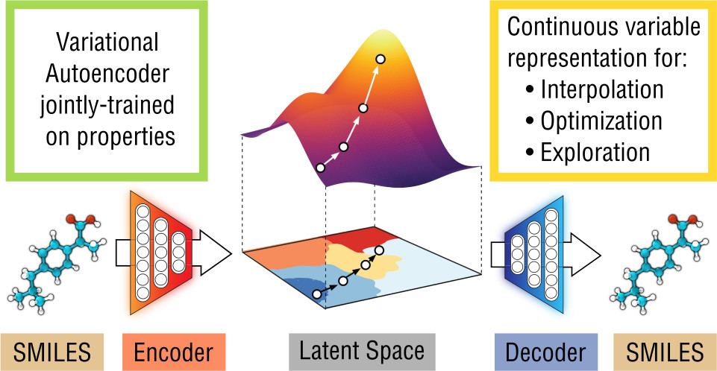
Drug design with variational auto-encoders; able to sample the latent space to find potentially interesting drugs
Gomez-Bombarelli et al. ACS Central Science (2023)
Notes:
https://pubs.acs.org/doi/10.1021/acscentsci.7b00572

Slide 21
Drug design with variational auto-encoders; able to sample the latent space to find potentially interesting drugs
Gomez-Bombarelli et al. ACS Central Science (2023)
Notes:
https://pubs.acs.org/doi/10.1021/acscentsci.7b00572

Slide 22
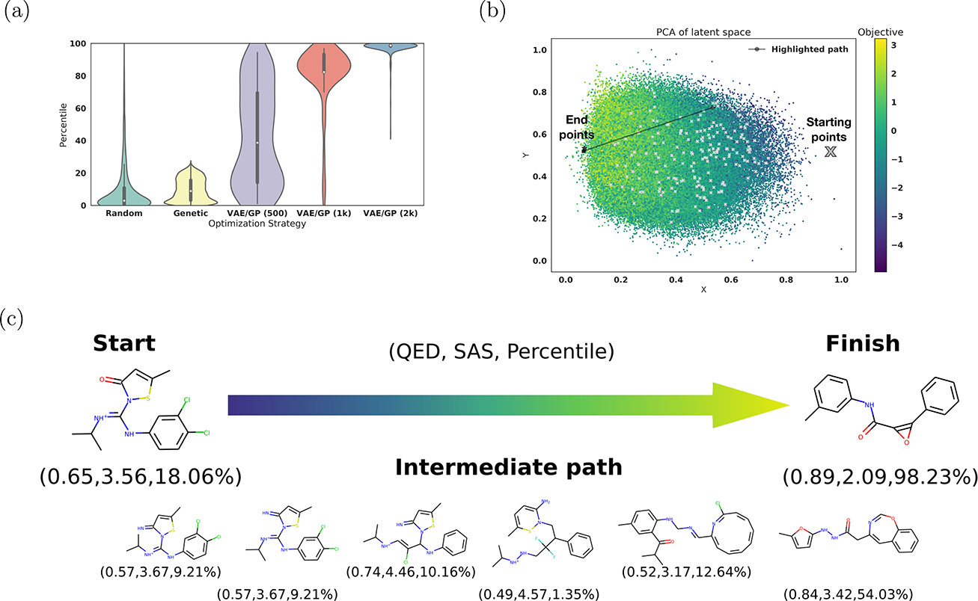
Reconstructing ibuprofen-like molecules yields much higher percentile (likeness) scores for the variational autoencoder
Gomez-Bombarelli et al. ACS Central Science (2023)
Notes:
https://pubs.acs.org/doi/10.1021/acscentsci.7b00572

Slide 23
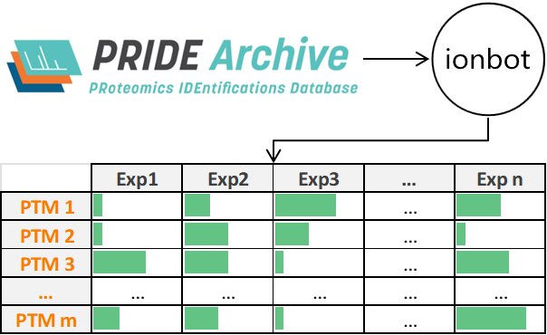
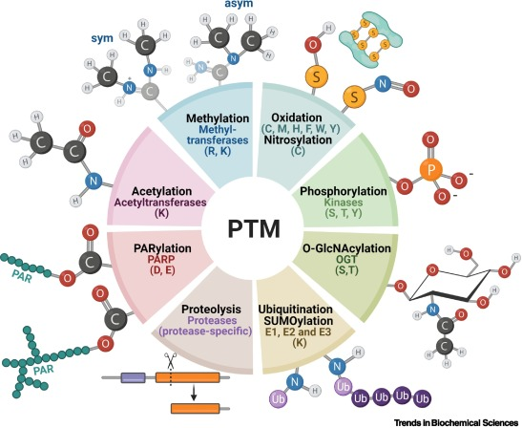
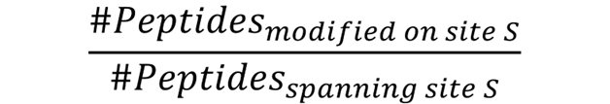
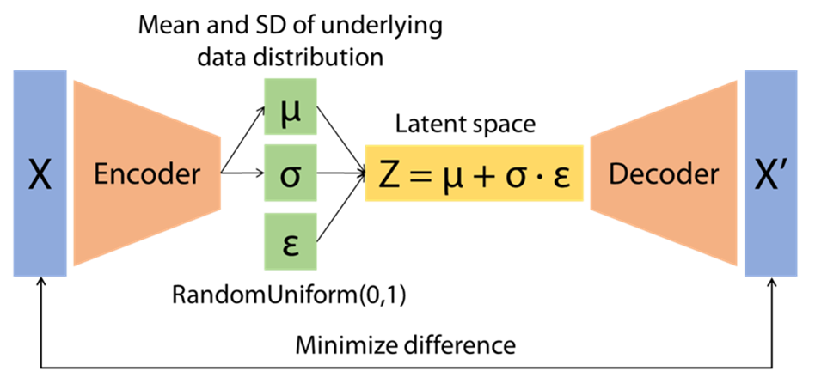
A VAE map of proteome-wide phosphosite co-occurrence reveals some interesting patterns, including kinase clusters
Koutrouli et al. Bioinformatics (2024)
Notes:
!!! Add Enrico picture

Slide 24
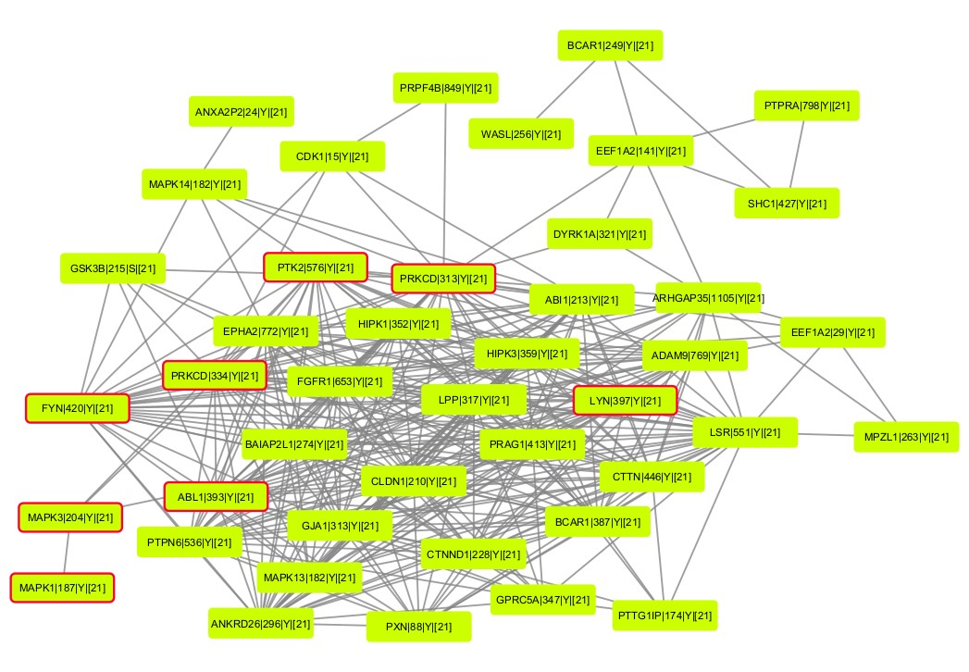
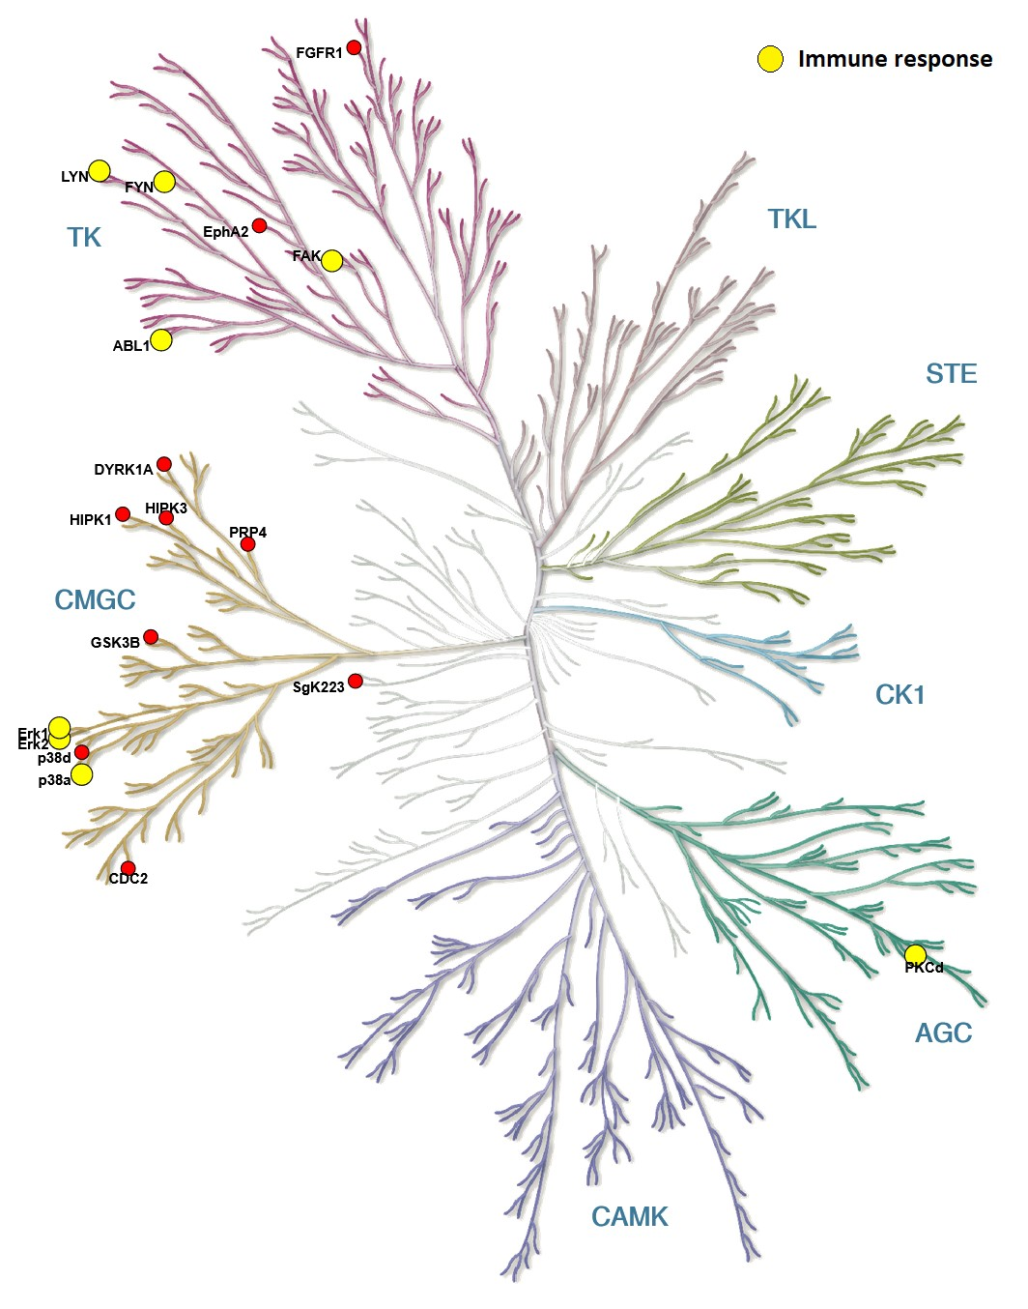
These phospho clusters contain connected components, here shown for tyrosine kinases and their key targets
Koutrouli et al. Bioinformatics (2024)

Slide 25
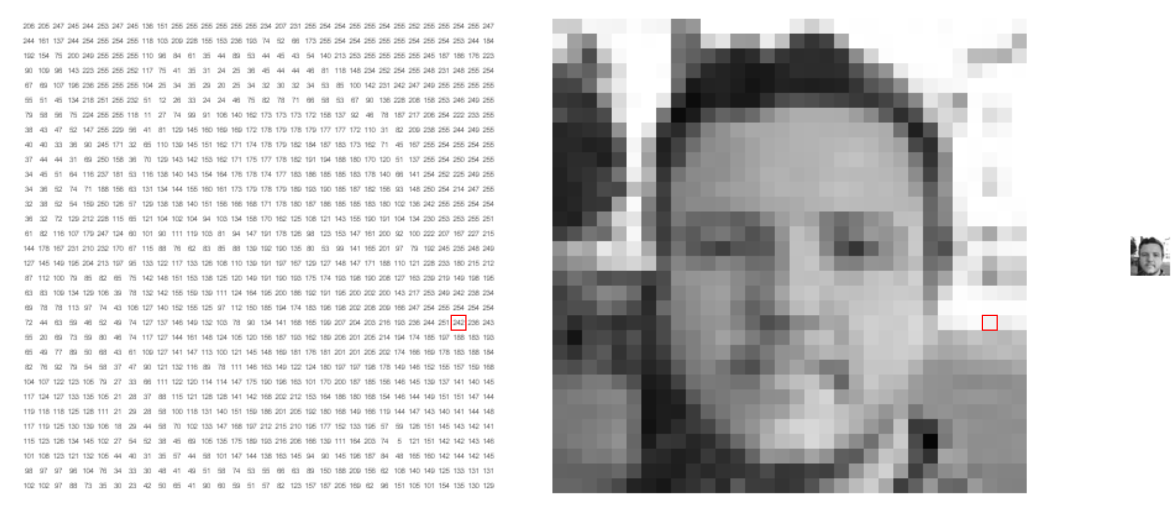
Computer vision is a large subfield in AI that deals with 2D and 3D images and videos
https://setosa.io/ev/image-kernels/

Slide 26
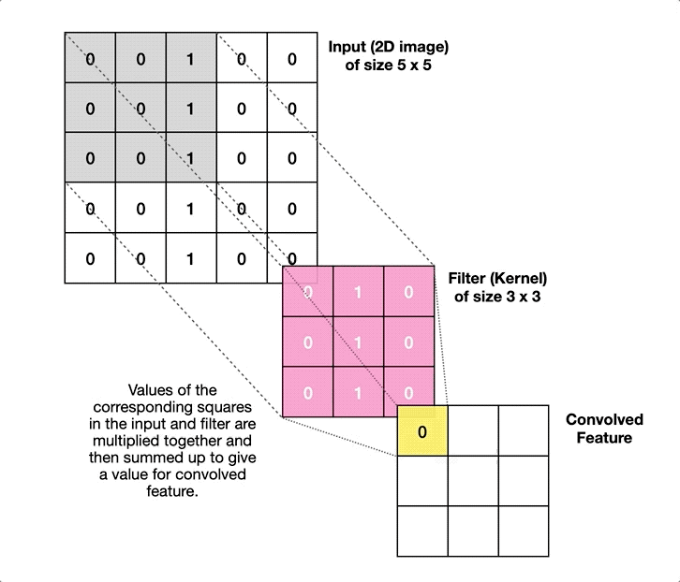
Filters are used to obtain small and unlocalized features of images that can be combined in subsequent convolutional layers

Slide 27
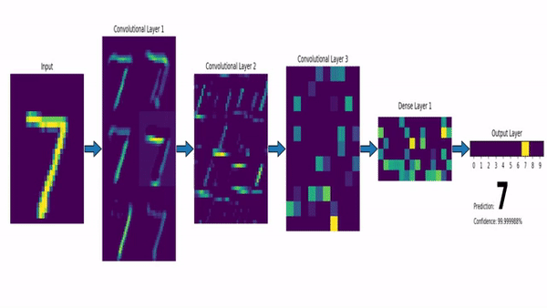
Filters are used to obtain small and unlocalized features of images that can be combined in subsequent convolutional layers

Slide 28
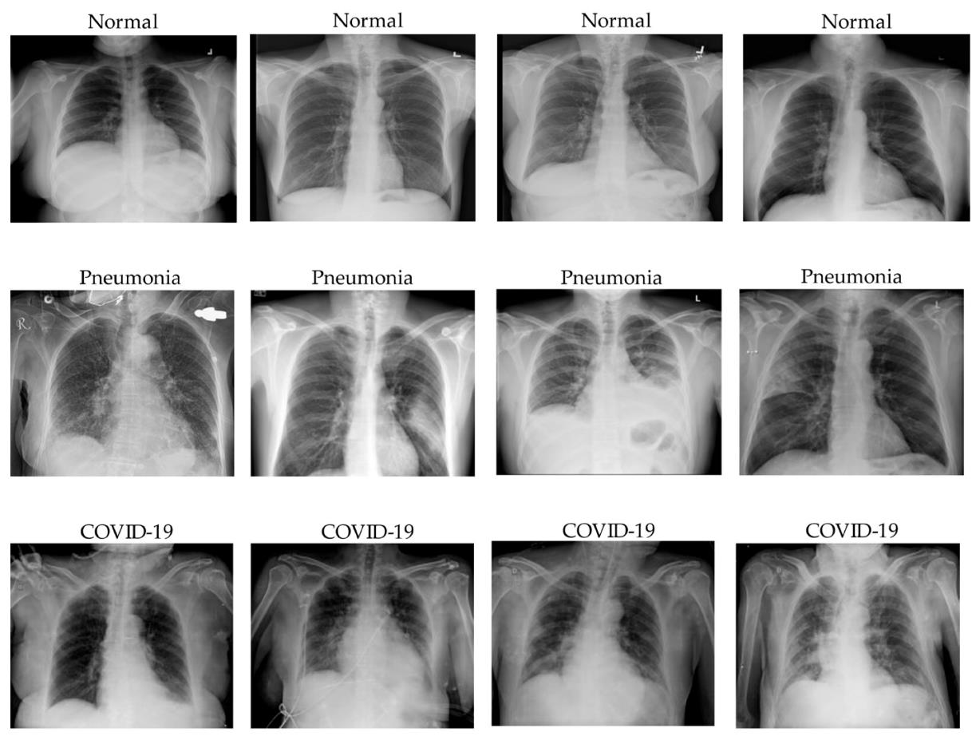
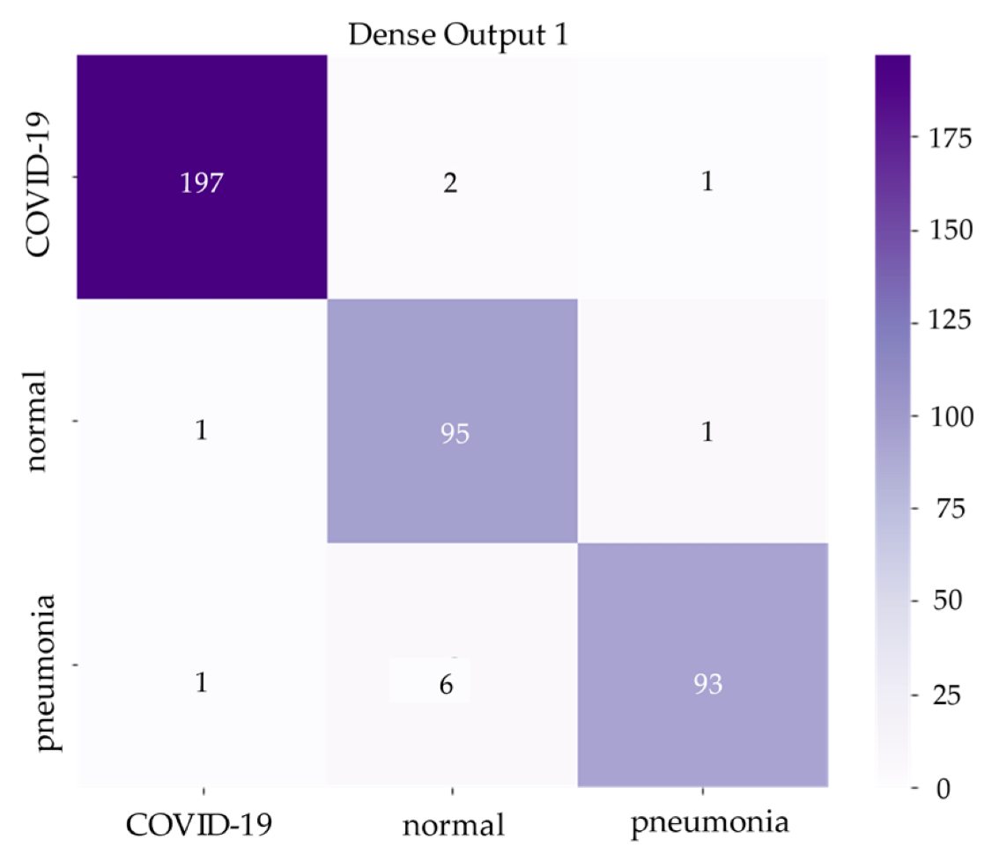
COVID can be detected with high sensitivity and specificity, and also be distinguished from pneumonia
Predictions
True labels
Le Dinh, T, et al. COVID-19 Chest X-ray Classification and Severity Assessment Using Convolutional and Transformer Neural Networks. Appl. Sci. 2022, 12, 4861
Notes:
!!! Change the reference

Slide 29


Artificial Intelligence in Medicine How Can AI Help Us Understand Disease and Improve Patient Care?
Robbin Bouwmeester

Slide 30
ML trains a model from experience (data) with respect to a task and performance measure that should be able to generalize
Using Pigeons to Diagnose Cancer | Scientific American

Slide 31
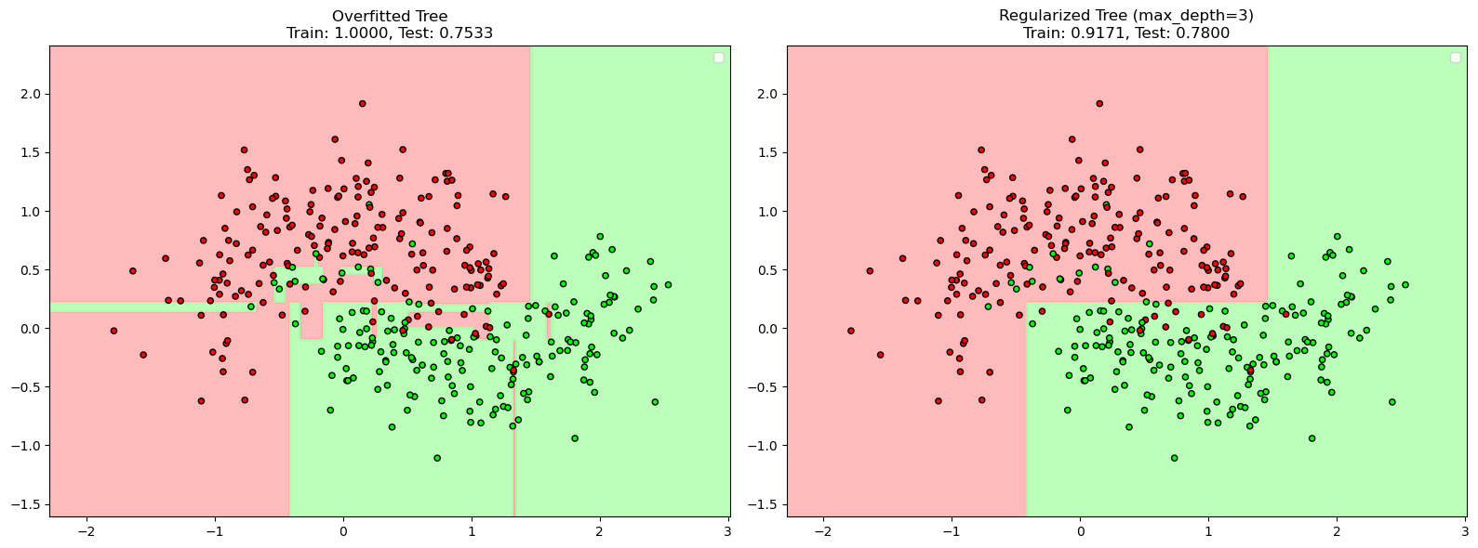
AI cheating

Slide 32
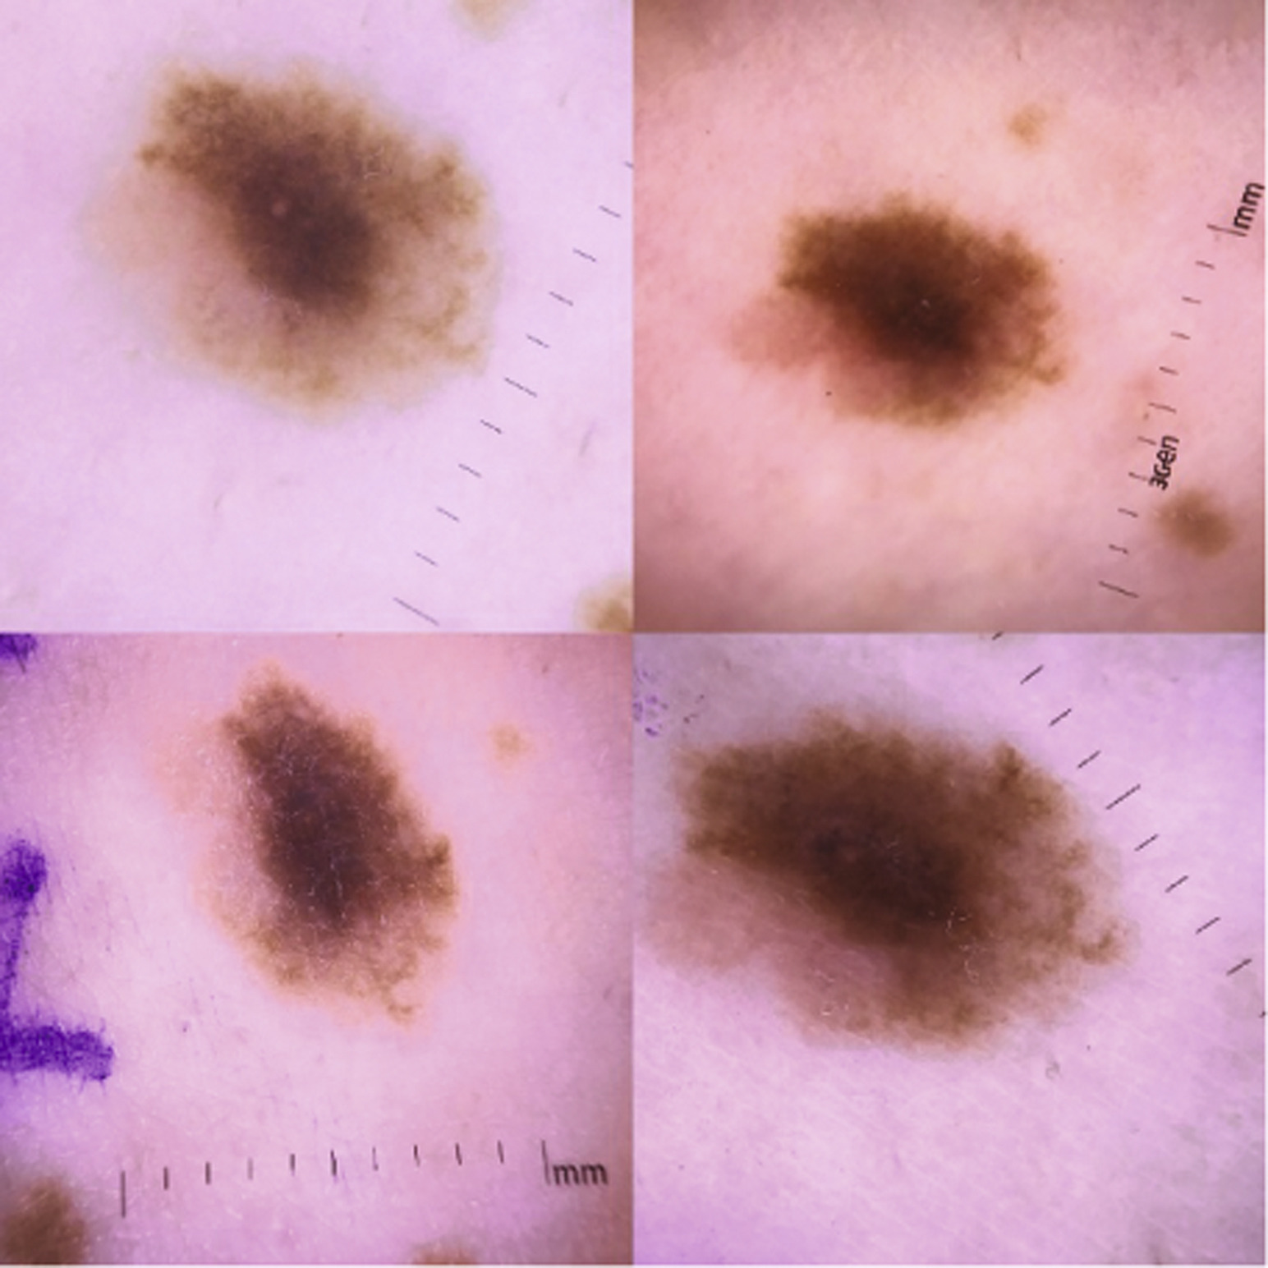
AI cares about optimizing the objective function; AI can cheat
Automated Classification of Skin Lesions: From Pixels to Practice - Akhila Narla ∙ Brett Kuprel ∙ Kavita Sarin ∙ Roberto Novoa ∙ Justin Ko
Notes:
!!! Change ref

Slide 33
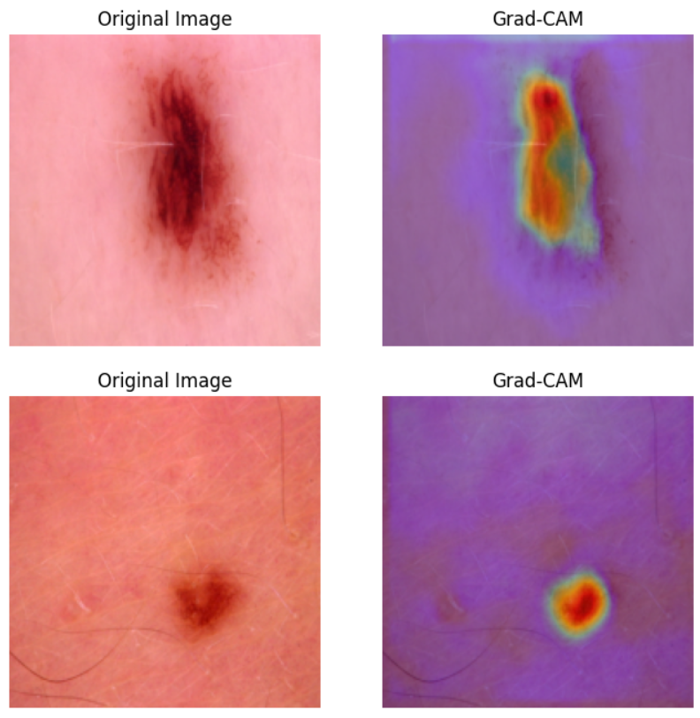
AI cares about optimizing the objective function; AI can cheat
Automated Classification of Skin Lesions: From Pixels to Practice - Akhila Narla ∙ Brett Kuprel ∙ Kavita Sarin ∙ Roberto Novoa ∙ Justin Ko

Slide 34

AI cares about optimizing the objective function; AI can cheat
github.com/CompOmics/ML-course-VIB-2024
Automated Classification of Skin Lesions: From Pixels to Practice - Akhila Narla ∙ Brett Kuprel ∙ Kavita Sarin ∙ Roberto Novoa ∙ Justin Ko

Slide 35
Conclusion and outlook
ML trains a model from experience (data) with respect to a task and performance measure that should be able to generalize
Different objectives, ML algorithms, and input data:
disease state, anomaly detection, segmentation, drug efficiency, IC50, drug stability, pathogenicity, structure, interactions, textual structure
tree-based, continuous, neural-network, recurrent NN, convolutional NN, transformer (LLM)
tabular, image, video, temporal ordered, sequence, structural, textual
Enormous amount of potential on a wide variety of problems
Future lies in a hybrid of humans working with AI, this also partly circumvents ethical and legal issues (there are still many ethical and legal issues though!)
Notes:
!!! Add qr to slides

Slide 36
Skin melanoma as a simplified example of how a model learns;
note that a computer only works with numbers!
Data (features)
Model
Target
Eccentricity
1
<= -2.0
> -2.0
0
2
0
1
1
-0.5
1.8

Slide 37
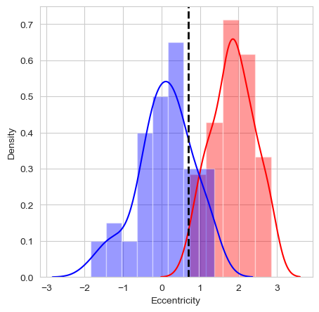
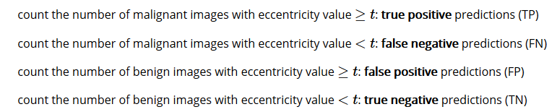
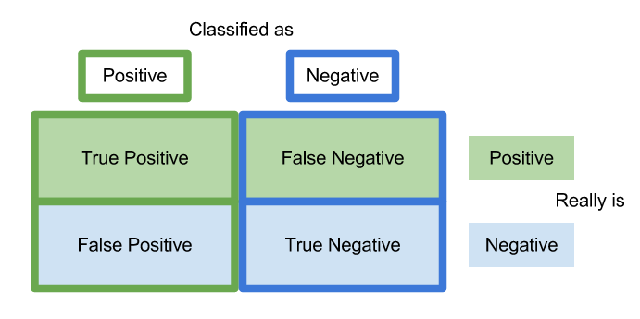
classification: prediction errors
malignant: positive class
benign: negative class

Slide 38
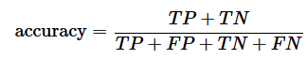
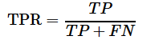
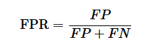
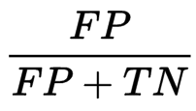
classification: prediction errors

Slide 39
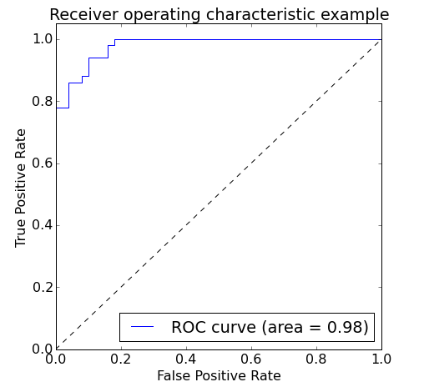
classification: prediction errors
model that classifies all images as malignant: TPR=1 and FPR=1
model that classifies all images a benign: TPR=0 and FPR=0
vary threshold t
Area Under the Curve (AUC)

Slide 40
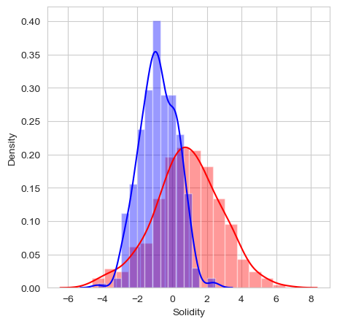
classification: multi-dimensional
add another feature?
feature vector X
Euclidean vector space

Slide 41
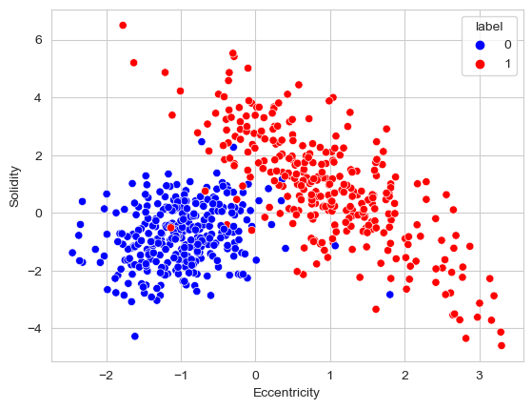
classification: multi-dimensional
feature vector X
Euclidean vector space

Slide 42
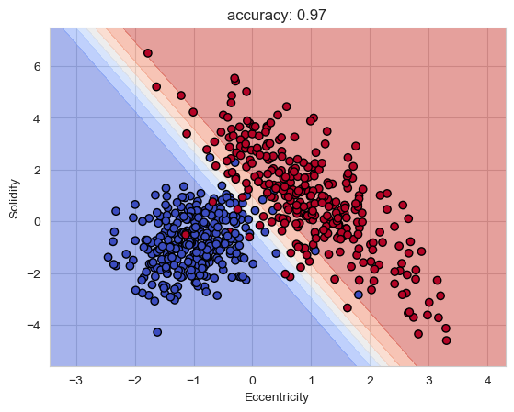
classification: multi-dimensional
linear decision boundary
blue region malignant, red region benign
yet more features
can’t look at the decision boundary
more complex

Slide 43
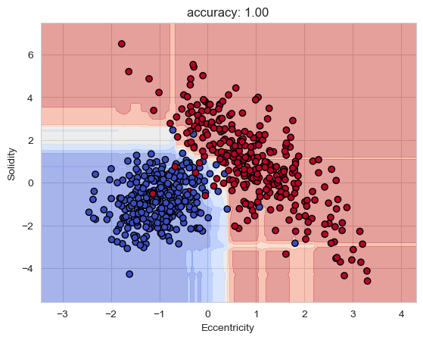
classification: model complexity
unseen external images
generalization
overfitting

Slide 44
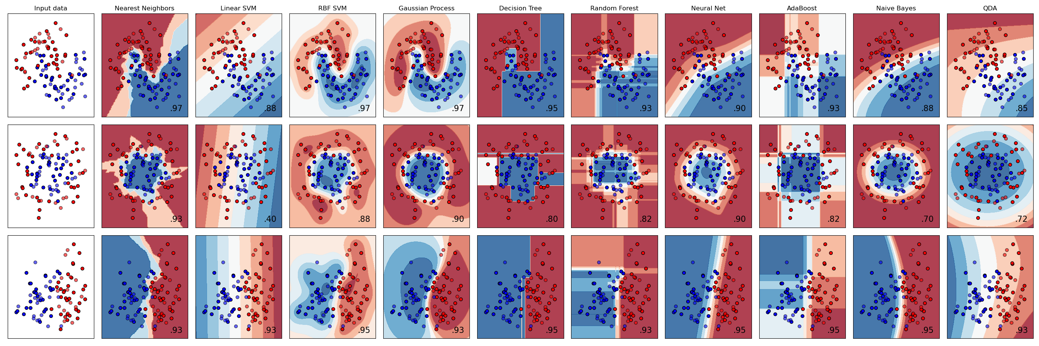
scikit-learn

Slide 45
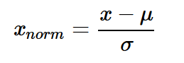
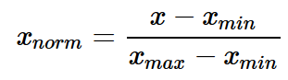
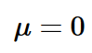
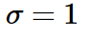
data normalization
make all features same scale
Eccentricity [0,100], Solidity [-5,7]
weights all features equally in their representation
standardization
min-max scaling: scale the features to a fixed range

Slide 46
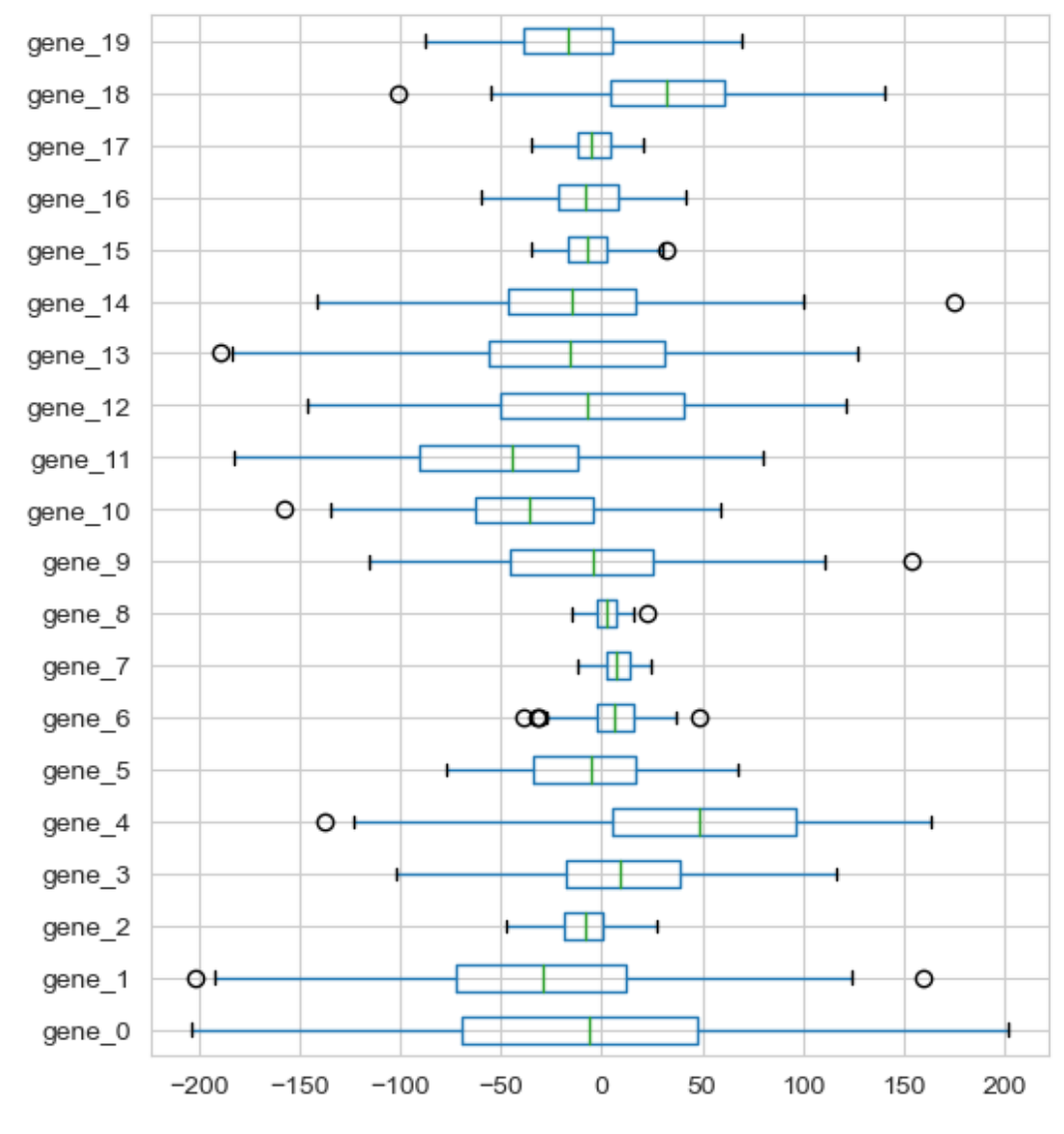
data normalization

Slide 47
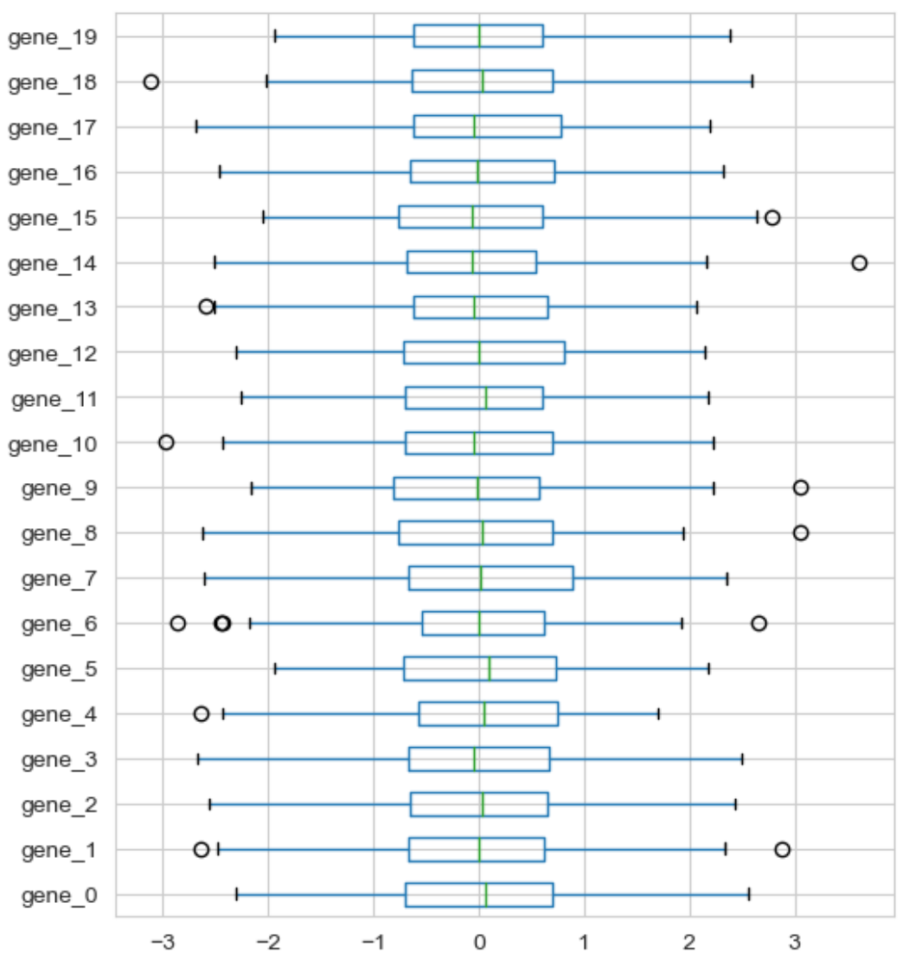
data normalization: standardization

Slide 48
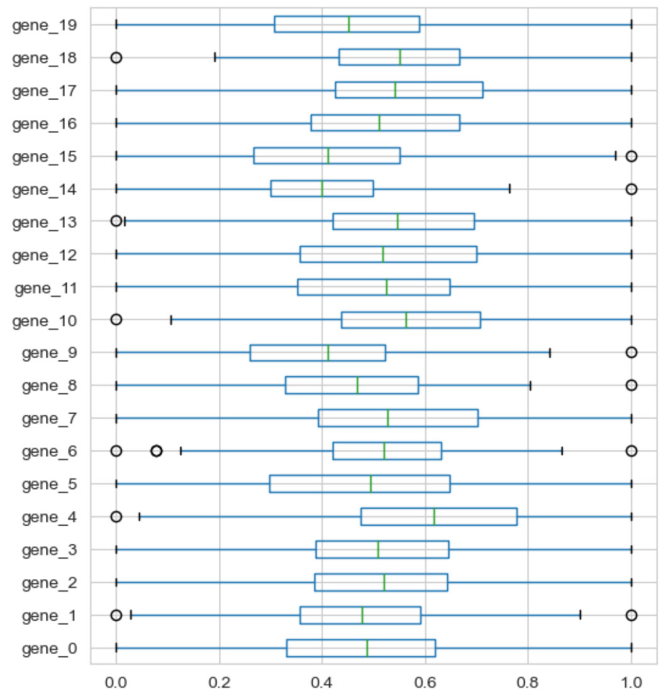
data normalization: min-max scaling

